Slide 1
All About Git Source Control
Code Norman December 19

Slide 2
About Me
Brian Chirgwin
  Full Stack AngularJS / NodeJS application developer
  Constantly Learning & like to share knowledge
  Developing a full stack developer course in my spare time

Slide 3
Last Meeting
Software for the City of Norman
New Developers

Slide 4
Future Meetings
January
  Editors/IDE
    Webstorm
    Visual Studio Code
February
  Code Workflow
Future
  Docker
  Functional Programming
  NoSQL (MongoDB, Redis, CouchDB )
  JS, Meteor, Processing JS

Slide 5
Agenda
Overview of version source control
git overview. How it is different?
Common git Commands
Break
Other git commands

Slide 6
First version control
copy folder project to v1
copy folder project to v2
copy folder project to v3

Slide 7
Version Control Systems
Maintain changes to source code from multiple developers.
Centralized
  Client/server
  Library
  Must be online
Distributed
  Every developer has a complete copy of repository
  Fast local commits, push to server
  commits more often, smaller changes, fewer merge conflicts

Slide 8
What is Git?
Linus Torvald
  Source Control for Linux Kernel (2005)
  Large projects
Distributed Version Control
Two phase commit
Online cloud repositories with GitHub and BitBucket.

Slide 9
sha1 hash

Slide 10
Linux
9,868,933 lines of code, 12,020,528 lines with comments included, spread over 36,595 unique files.
Breakdown by language
C - 7,896,318 lines, 16,397 files
C/C++ Header files - 1,629,064 lines, 13,542 files
Assembly - 250,097 lines, 1,231 files
DocBook XML - 40,070 lines, 140 files
Makefiles - 23,589 lines, 1,421 files
Perl - 14,839 lines, 41 files
Shell Script - 4,103 lines, 76 files
yacc - 2,978 lines, 5 files
Python - 2,549 lines, 18 files
C++ - 1,524 lines, 1 file
lex - 1,321 lines, 5 files
awk - 714 lines, 8 files
Bash Script - 446 lines, 28 files
HTML - 378 lines, 2 files
NAnt Script - 372 lines, 1 file
Lisp - 218 lines, 1 file
ASP - 137 lines, 1 file
m4 - 84 lines, 1 file
XSLT - 70 lines, 6 files
sed - 30 lines, 1 file
Vim Script - 27 lines, 1 file
Teamcenter def - 5 lines, 1 file
https://www.quora.com/How-many-lines-of-code-are-in-the-Linux-kernel

Slide 11
Most Version Control - Changes
Version 1
Version 2
Version 3
Version 4
Version 5
File A
A1
A2
File B
B1
B2
File C
C2

Slide 12
Git - Snapshots
Version 1
Version 2
Version 3
Version 4
Version 5
File A
A1
A2
A2
A2
File B
B
B1
B1
B2
File C
C
C
C2
C2
hash
hash
hash
hash
hash

Slide 13
What is a repository?
An archive of a project’s code and changes are maintained.
Includes:
  Sources
    JavaScript, CSS, html (C#, C++, etc…)
  Assets
    Images, Fonts
  Documentation
Not included:
  Compiled/transpiled (exe or typescript output JS files)
  3rd party libraries (node_modules, bower, dlls, etc…)

Slide 14
Process Flow
Master Branch, development branch, feature branch
  Checkout branch
  Create feature branch
  Write & pass test
  Commit
  Repeat adding tests until feature complete
Push branch to remote
  Fetch development
  Merge development
  Resolve merge conflicts (if any)
  Make sure it works
  Push branch
  Create pull request (PR)

Slide 15
Installation
Git
Win Merge
git config --global user.name "Brian Chirgwin"
git config --global user.email "brian@chirgwin.net"
git config --global color.ui auto
git config --global merge.tool winmerge
git config --global core.editor <editor>

Slide 16
Help
git
  Will list commands
git help <command>

Slide 17
git two phase commit
Workspace
  Source code you are working on
Staging
  Area where changes are staged before being committed into local repository
  Allows rollback before commit
Repository
  Commit to repository

Slide 18
file states
Untracked
  Not tracked in git repo
Tracked
  Unmodified
    tracked by git repo and hasn’t been changed
  Modified
    tracked by git repo and has been changed
  Staged
    tracked by git repo, has been changed, staged for commit

Slide 19
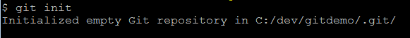
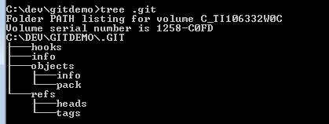
Create a repository
git init

Slide 20
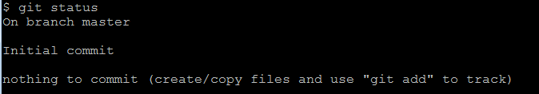
git status

Slide 21
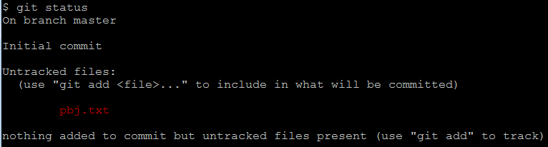
Add files
Create file
pbj.txt is untracked

Slide 22
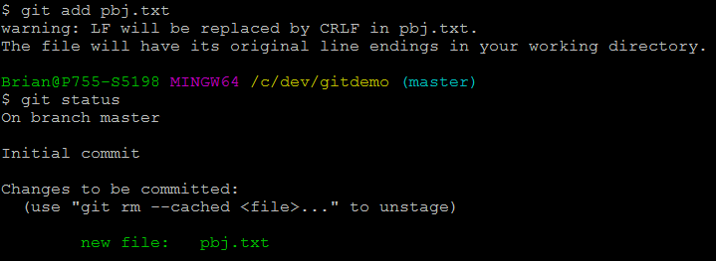
Add files
git add <filename>

Slide 23
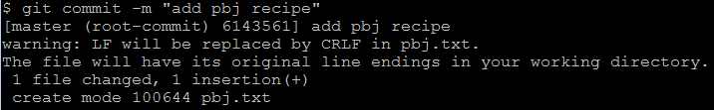
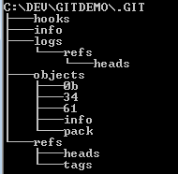
git commit

Slide 24
Remove file
git rm <filename>
  remove workspace and repository
git rm --cached <filename>
  Keep in workspace, stop tracking in repository

Slide 25
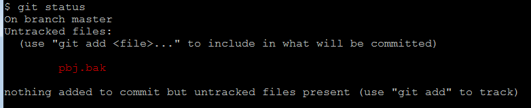
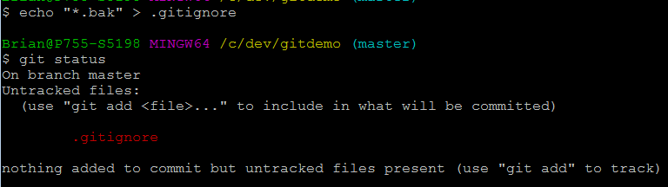
.gitignore

Slide 26
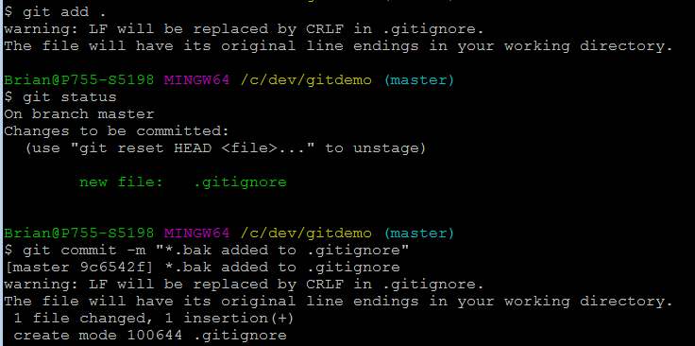
.gitignore

Slide 27
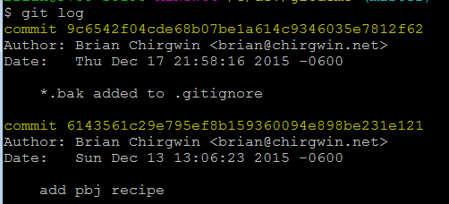
git log

Slide 29
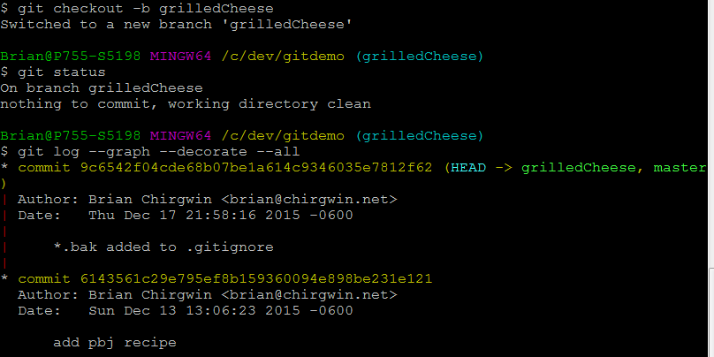
Create a branch

Slide 30
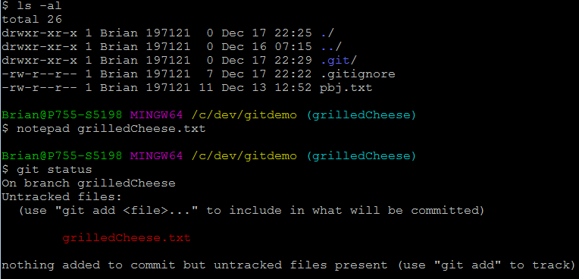
Add file

Slide 31
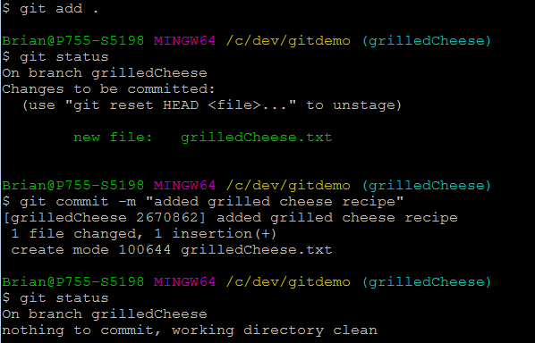
Commit Branch

Slide 32
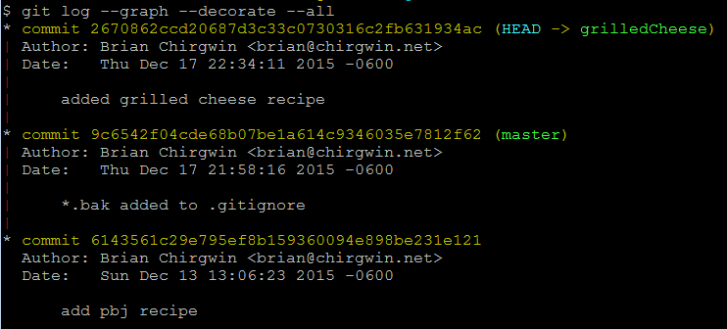
Commit Branch

Slide 33
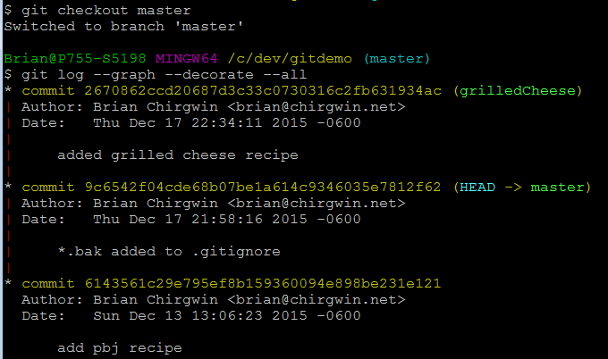
Checkout Branch

Slide 34
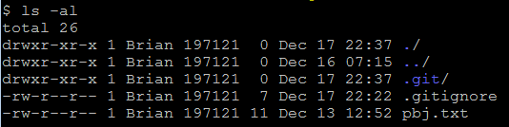
Checkout Branch

Slide 35
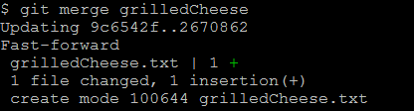
Merge Branch

Slide 36
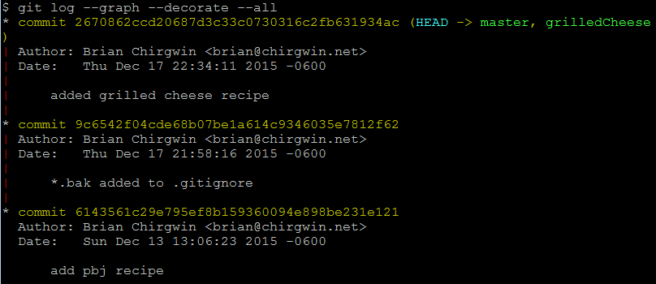

Merge Branch

Slide 37
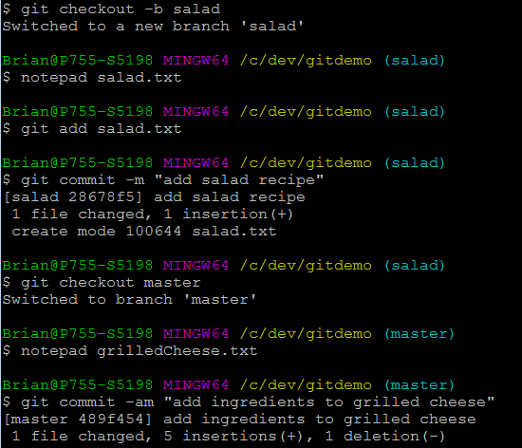
Branch salad & master

Slide 38
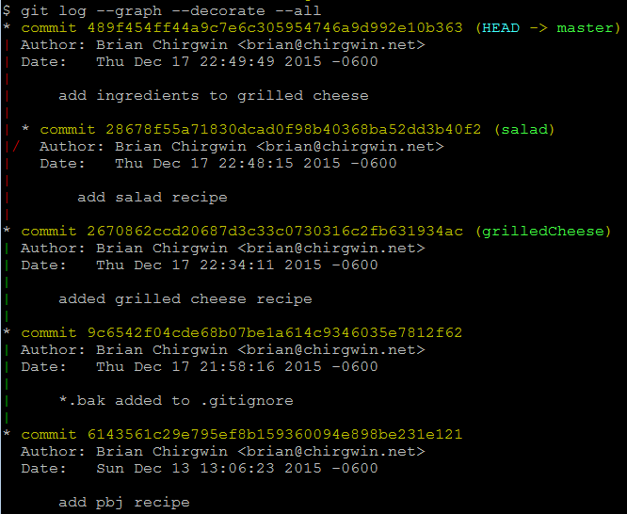
Branch salad & master

Slide 39
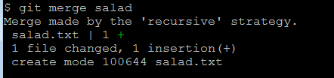
git merge

Slide 40
merge strategies
fast forward
resolve
recursive
  ours
  theirs
  patience
  diff-algorithm
  ignore-space-change, ignore-all-space, ignore-space-at-eol
  renormalize
  no-renormalize
  rename-threshold=<n>
  subtree[=<path>]
octopus
ours
subtree
http://git-scm.com/docs/merge-strategies

Slide 41
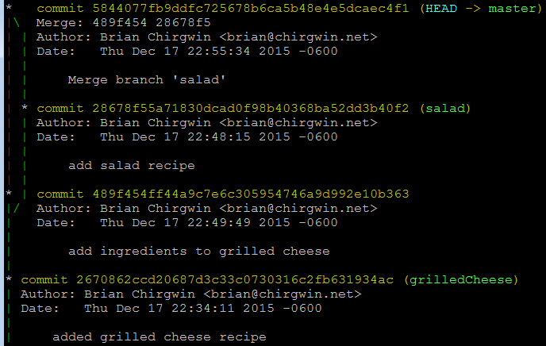
git merge

Slide 42
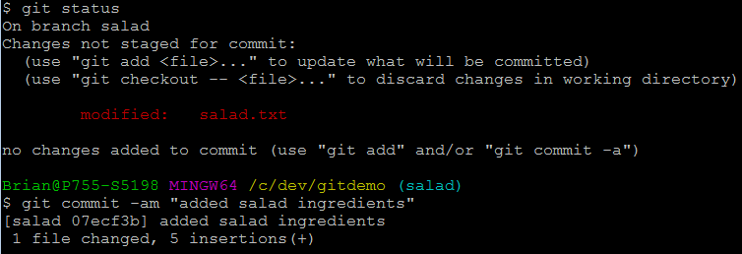
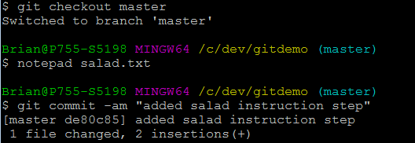
Resolve merge conflict

Slide 43
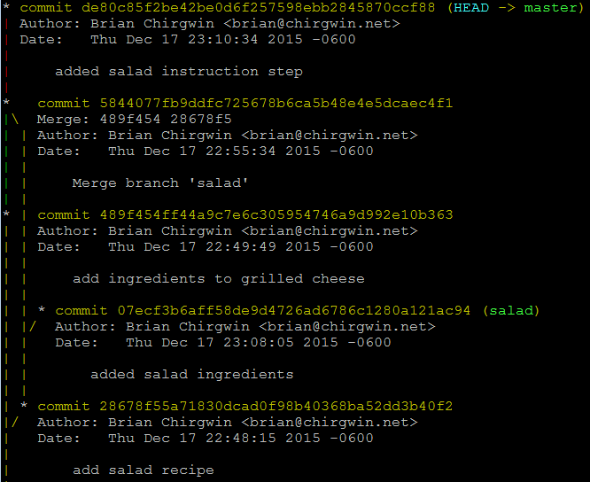
Resolve merge conflict

Slide 44

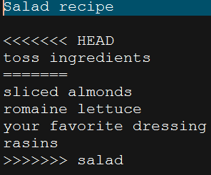
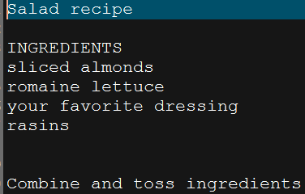
Resolve merge conflict

Slide 45
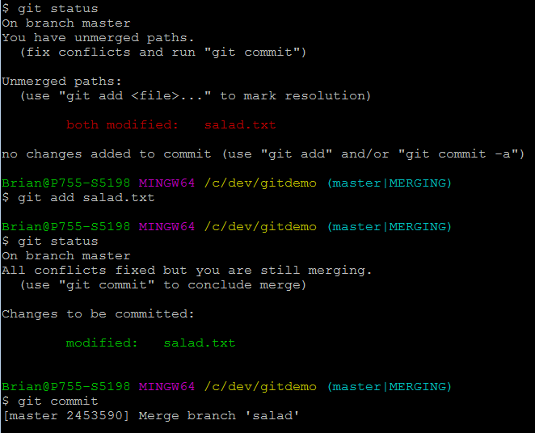
Resolve merge conflict

Slide 46
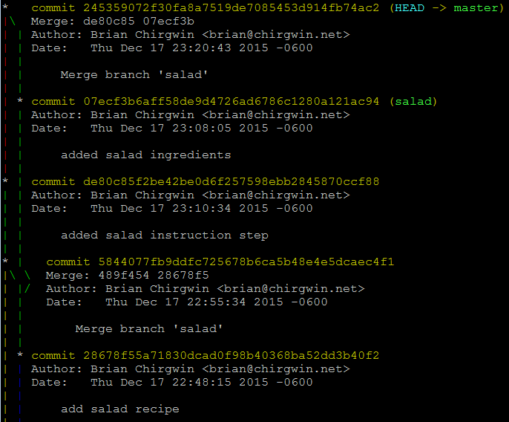
Resolve merge conflict

Slide 47
Remote repositories
A remote repository is the same as a local repository
  no workspace
  Developers push / pull commits
origin
developer 1
developer 2
developer 3

Slide 48
Remote repositories
git remote
git remote -v
  $ git remote show origin
git push <remote name> <branch>
git fetch –all
  Fetch all updates on all branches from remote
git pull
  Performs fetch & merge in one command
  No ability to check log first

Slide 49
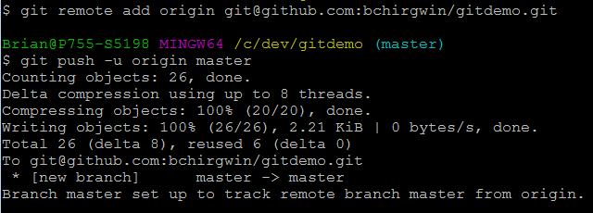
Create remote repository
git remote add origin git@github.com:bchirgwin/gitdemo.git

Slide 50

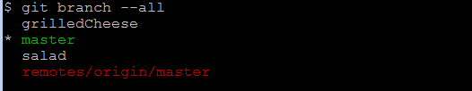
Create remote repository

Slide 51
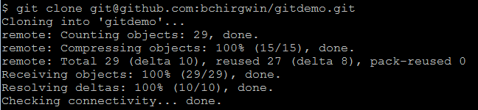
git clone
git clone <repo>

Slide 52
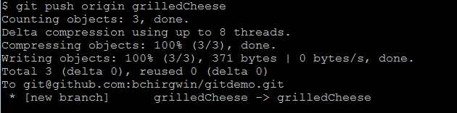
git push
git push –u origin <remote-branch-name>
-u remembers what branch it goes to in remote

Slide 53
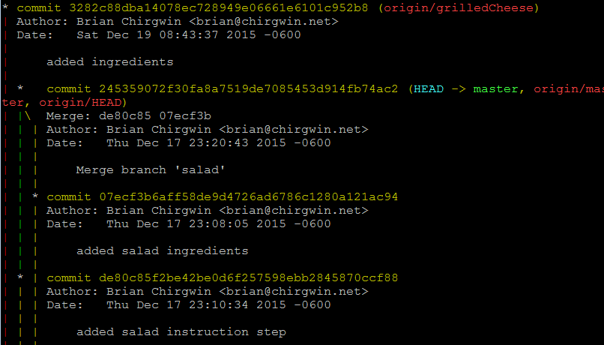
git push

Slide 54
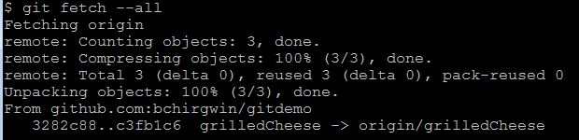

git merge

Slide 55
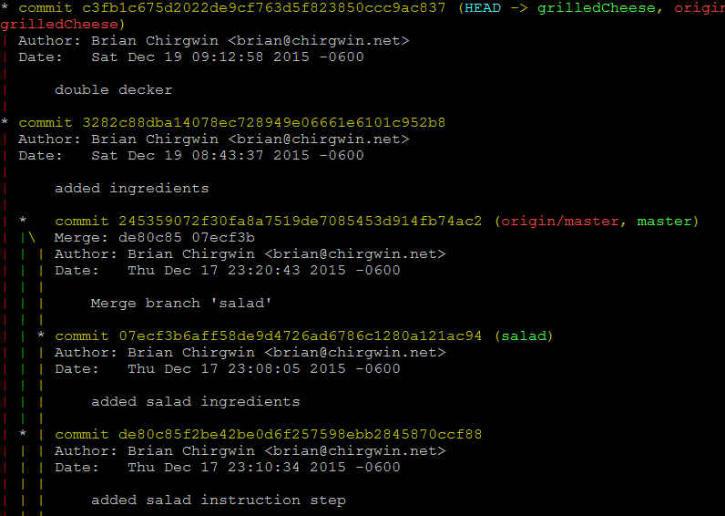

Slide 56
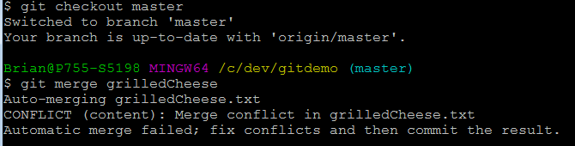
get merge to master

Slide 57
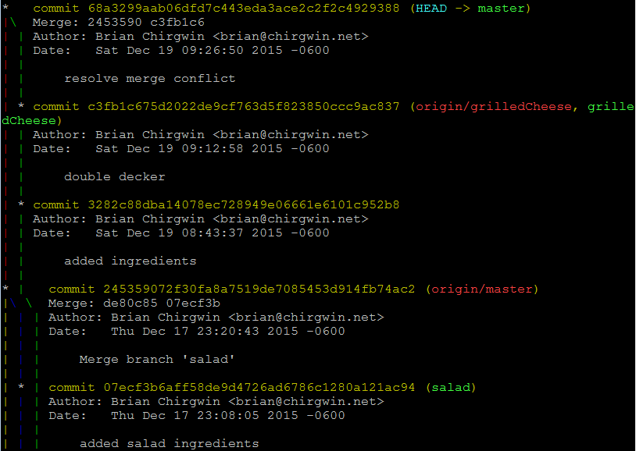

Slide 58
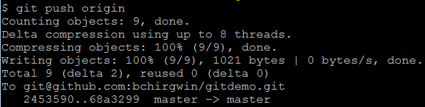
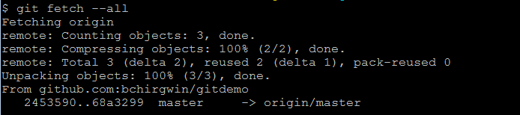
push changes

Slide 59
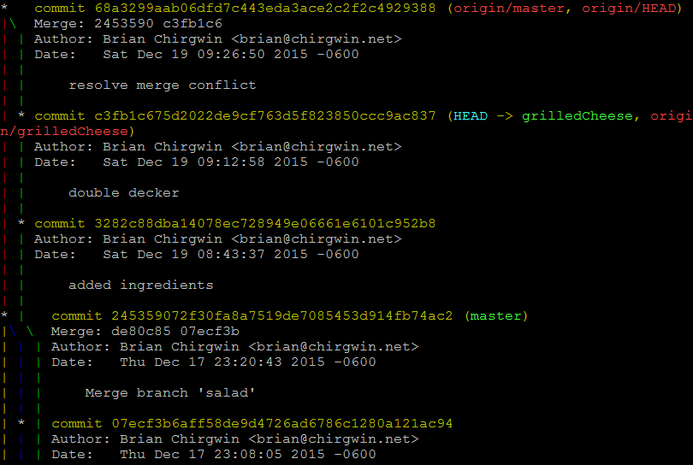

Slide 60

delete branch
git branch -d <local branch>
git push --delete origin <branch>
  git push origin :<branch>

Slide 61
Git stash
Git stash
Git stash apply

Slide 62
Git tag
Git tag v1.0 <commit id>
  Git push --tags

Slide 63
Git push
Commit id = sha1( content + author + date + log + previous commit)
  Every commit history can be identify

Slide 64
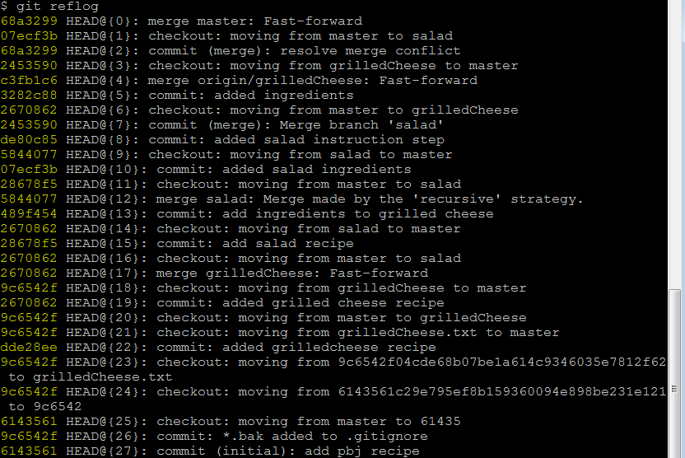
reflog
Displays all recent activity

Slide 65
Git rebase
Git rebase --i HEAD^^

Slide 66
Git blame
git blame <filename>

Slide 67
git summary
Workspace
Staging area
repository
Branch
Head pointer, Remote pointer references, tag pointer reference

Slide 68
Git clone --mirror
Includes all refs to remote branches

Slide 69
$ git reset --hard
$ git log --pretty=oneline
git reflog
git reflog -g

Slide 70

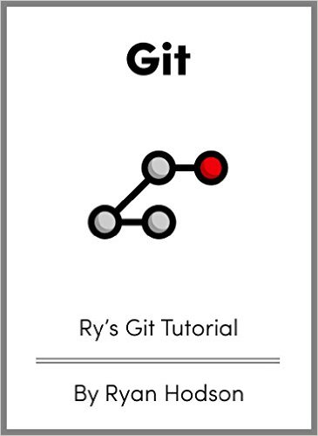

Resources
Git for ages 4 and up (free)
  https://www.youtube.com/watch?v=1ffBJ4sVUb4
Pro Git (read online free)
  https://git-scm.com/book/en/v2
Rys Git Tutorial (free)
  http://www.amazon.com/Rys-Git-Tutorial-Ryan-Hodson-ebook/dp/B00QFIA5OC/ref=sr_1_1?ie=UTF8&qid=1450624864&sr=8-1&keywords=ry%27s+git
Learn Git in a month of lunches
  https://www.manning.com/books/learn-git-in-a-month-of-lunches

